Slide 1
Implementation Diagram

Slide 2

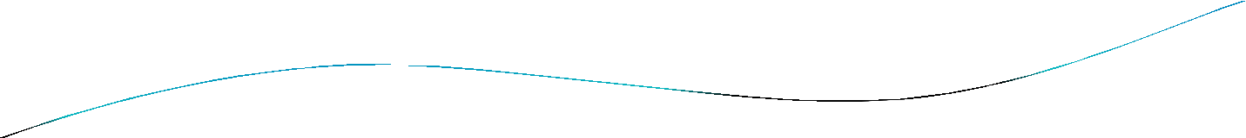


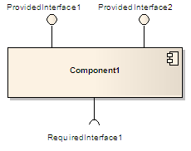

Component(UML)
 A component in the Unified Modeling
Language "represents a modular part of a system, that encapsulates its content and whose manifestation is replaceable within its environment. A component defines its behavior in terms of provided and
required interfaces".^{[1]}
Manifestation : an event, action, or object that clearly shows or embodies something abstract or theoretical.

Slide 3

Component (UML)
A component may be replaced by another if and only if their provided and required interfaces are identical.
This idea is the underpinning for the plug-and- play capability of component-based systems and promotes software reuse.
UML places no restriction on the granularity of a component. Thus, a component may be as small as a figures-to-words converter, or as large as an
entire document management system.
Such assemblies are illustrated by means of component diagrams.

Slide 5

Implementation Diagrams
Both are structural diagrams
Component Diagrams:
set of components and their relationships
Illustrate static implementation view
Component maps to one or more classes, interfaces, or
collaborations
Deployment Diagrams:
Set of nodes and their relationships
Illustrate static deployment view of architecture
Node typically encloses one or more components

Slide 6


Component Diagram
Classes
Interfaces
Dependency, generalization, association, and realization relationships
Example.java
Special kind of class diagram focusing on system’s components.

Slide 7

Interfaces
Definition:
Collection of operation signatures and/or attribute defns
Defines a cohesive set of behaviors
Realized by:
Implemented by classes and components
Implement operations/attributes defined by interface
Relationships:
A class can implement 0ne or more interfaces
An interface can be implemented by 1 or more classes
Notation:
Lollipop
Dashed arrow

Slide 8

UML Component Diagrams
Component diagram shows components, provided and required interfaces, ports, and relationships between them. This type of diagrams is used
in Component-Based Development (CBD) to describe systems with Service-Oriented Architecture (SOA).
Component-based development is based on assumptions that previously constructed components could be reused and that components could be replaced by some other "equivalent" or "conformant" components, if needed.

Slide 9

UML Component Diagrams
Component are intended to be capable of being deployed and re-deployed independently, for instance to update an existing system.
Components in UML could represent
logical components (e.g., business components, process components), and
physical components (e.g., CORBA components, EJB components, ATL, COM+ and .NET components, WSDL (Web Service Definition Language) components, etc.),

Slide 10

Online Shopping - Components
Summary: The diagram shows "white-box" view of the internal structure of three related subsystems: WebStore, Warehouses, and Accounting.
WebStore subsystem contains three components related to online shopping - Search Engine, Shopping Cart, and Authentication.
Accounting subsystem provides two
interfaces: Manage Orders and Manage Customers.
Warehouses subsystem provides two interfaces: Search Inventory and Manage Inventory used by other subsystems.

Slide 11
Online Shopping - Components
WebStore subsystem contains three components related to online shopping - Search Engine, Shopping Cart,
and Authentication.
Search Engine component allows to search or browse items by exposing provided interface Product Search and
uses required interface Search Inventory provided by Inventory component.
Shopping Cart component uses Manage
Orders interface provided by Orders component during checkout.
Authentication component allows customers to create account, login, or logout and binds customer to some account.
Accounting subsystem provides two interfaces - Manage Orders and Manage Customers.

Slide 12

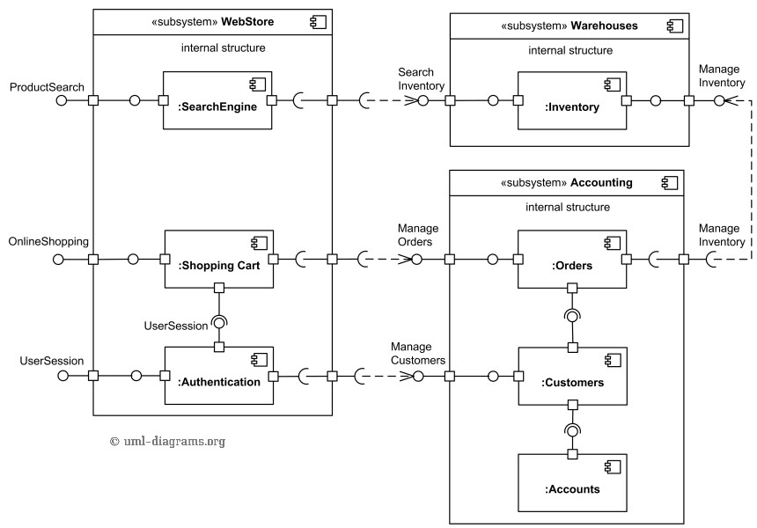
Ex1: Component Diagram

Slide 13

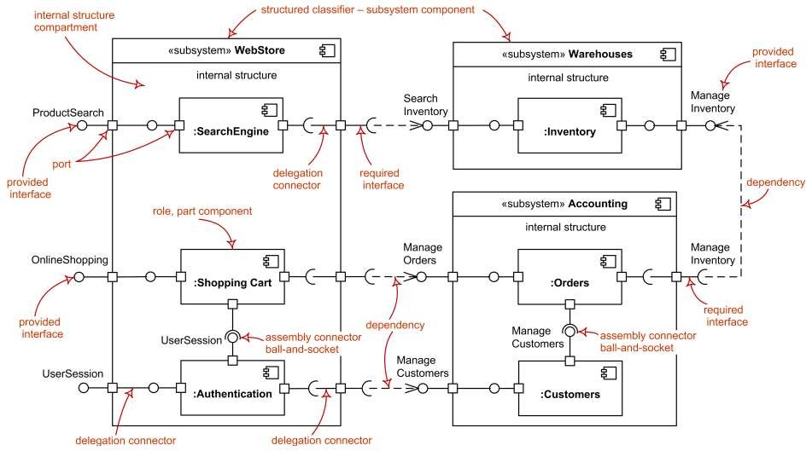
Ex1: UML Component Diagram

Slide 14

Online ordering / shipping
Online Ordering and Shipping applications uses Apache Struts framework forMVC. There isa Customer componentwhich provides XML (data) and ICustomer interfaces. There isan Orders componentwhich provides XML (data) and IOrderinterfaces.
Ordering Appuses IOrder & ICustomer interfaces toplaceorders. Shipping Apprequires XML data from Customer component & uses IOrderto link respectiveorders forshipping.
Security infrastrure provides IAccesControl & IEncryption interfaces. IAccesControl isused by Ordering, Shipping, Customers and Orders.
Persistence infrastructure hasa dependency on CorporateDB componentvia JDBC. Persistence infrastructure provides IPersistence used by Customers and Ordersto providestorage persistency for customerorders.

Slide 15

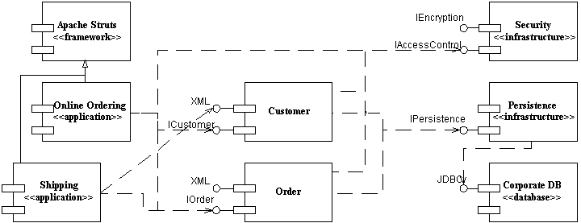
Ex3: Component Diagram

Slide 16


Slide 17
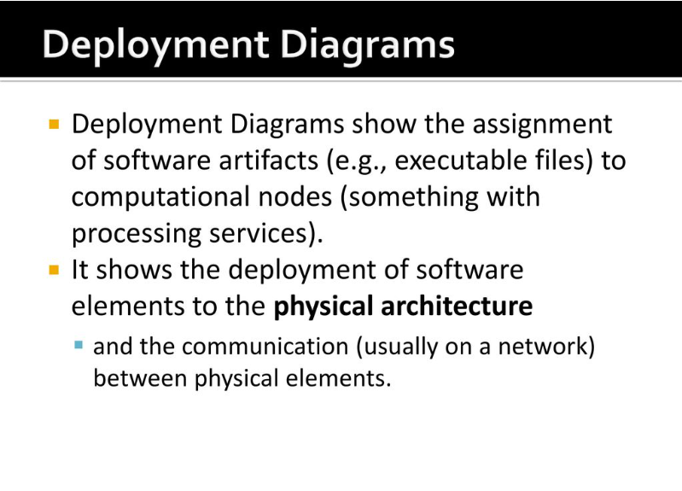

Slide 18
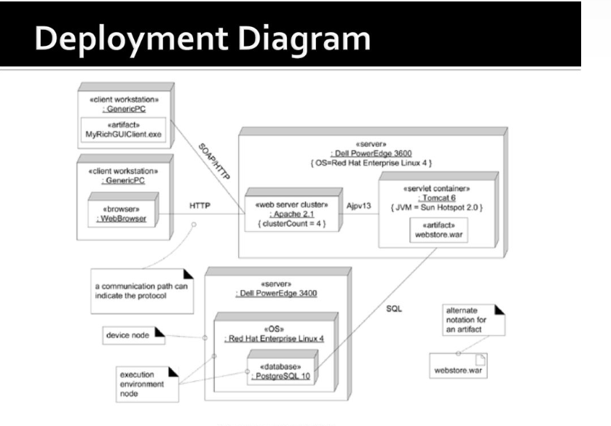

Slide 19
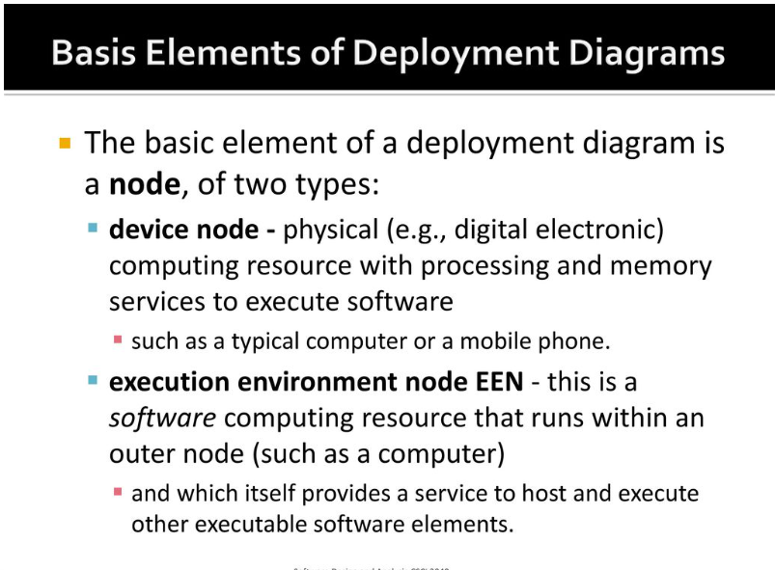

Slide 20
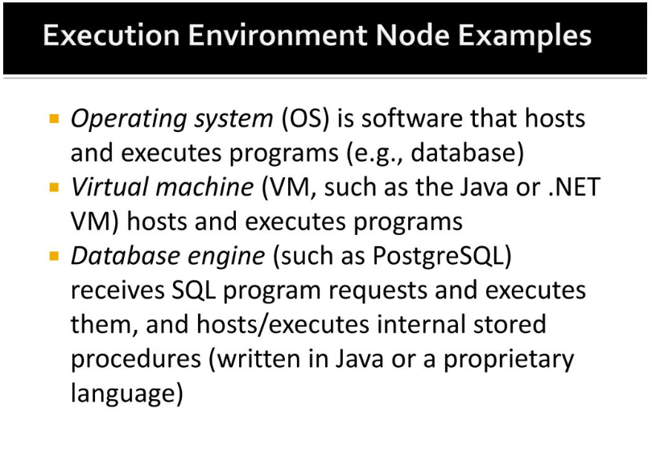

Slide 21
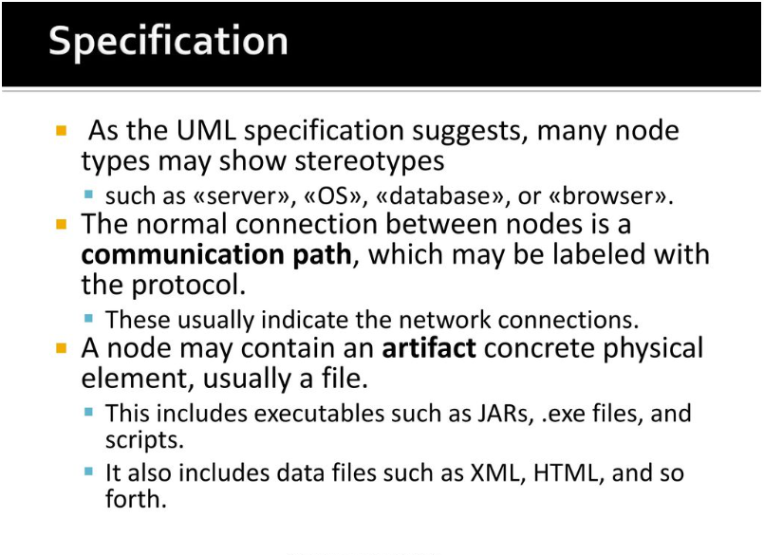

Slide 22
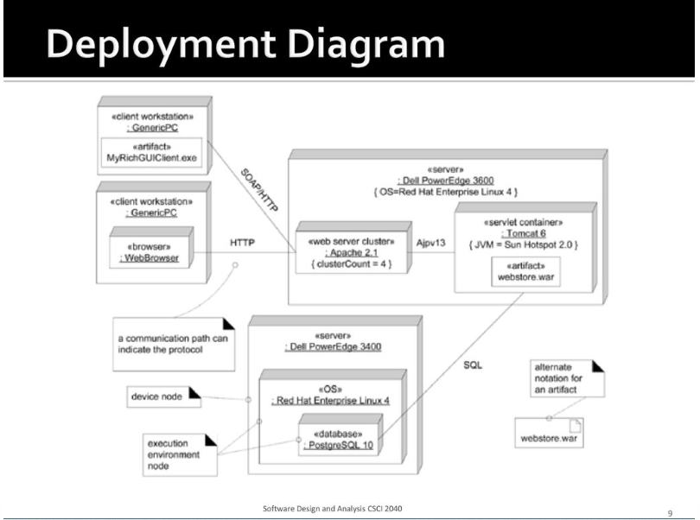

Slide 23
Assuming Chawla Super store consists one main database that holds information about products, sales, purchases, inventory and customers. The Chawla Store Point of Sales (POS) counter is where the customer arrives with the items to be purchased. The cashier records each item, price and adds the item information to the running sales transaction. The description and price of the current item are displayed on screen.
On completion of the item entry the cashier informs about the total to customer. The customer can pay via card or cash. After the payment is made, the system automatically generates a receipt through a printer and updates the inventory in the database. The entire system is connected through Local Area Network (LAN) and the card machines are connected through WIFI that process transactions on behalf of the banks. Draw deployment diagram for Chawla super store sales system.

